Slide 1
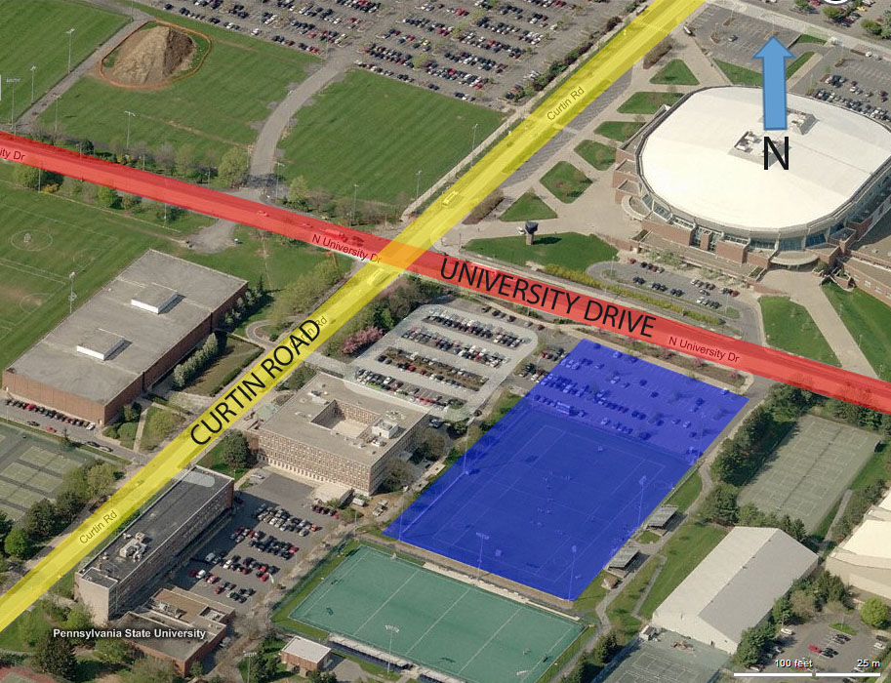
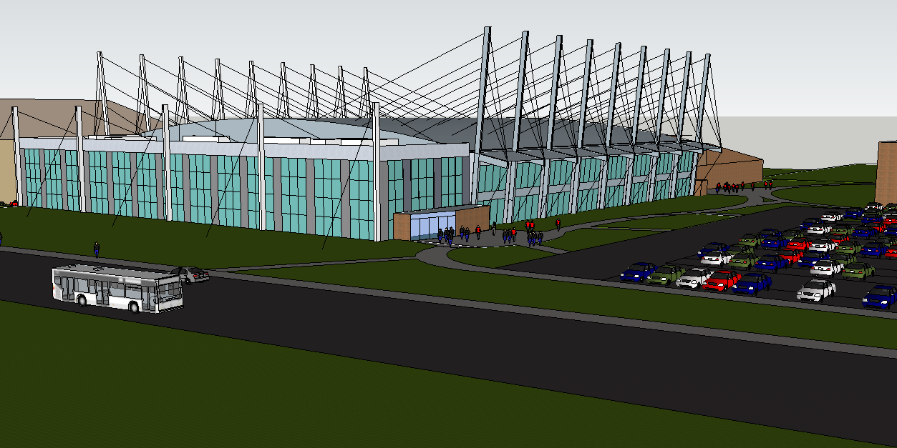
Ipd/bim Thesis proposal
Mission Statement:
To deliver innovative designs, with an integrated, streamlined approach to building systems and construction management
Nate Babyak Alex Ho Brian Sampson Alex Schreffler

Slide 2
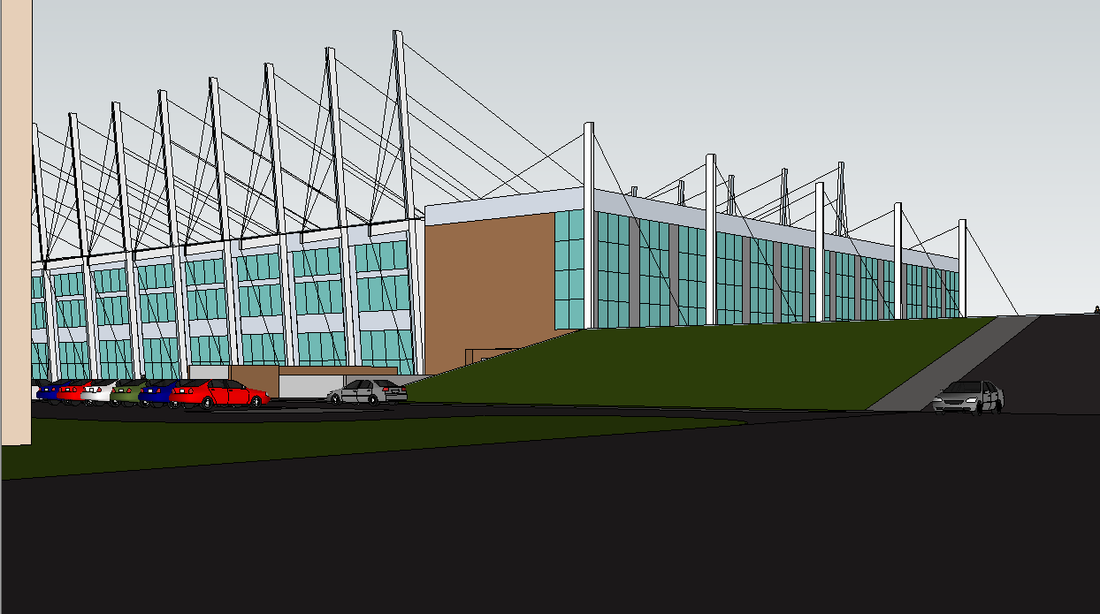
Introduction BIM Goals/Coordination Main Roof Redesign Façade Redesign Community Rink Redesign Conclusion
Agenda
BIM Goals/ Coordination
Main Roof Redesign
Façade Redesign
Community Rink Redesign
Conclusion
Nate Babyak Alex Ho Brian Sampson Alex Schreffler

Slide 3
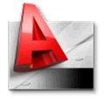
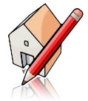
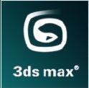
Introduction BIM Goals/Coordination Main Roof Redesign Façade Redesign Community Rink Redesign Conclusion
BIM Goals
Proposal Focuses
Program Coordination
Priority (1-3) | Goal Description | Potential BIM Uses
1-Most Important | Value Added Objectives
1 | Recognize design conflicts before they reach construction | 3D Coordination, Design Review, Design Authoring
1 | Create an energy efficient arena | Energy Analysis, Lighting Analysis, Building System Analysis, Site Analysis, Design Authoring, Sustainability LEED Evaluation
2 | Design with constructability in mind | 3D Coordination, 4D Modeling, Cost Estimation, Design Authoring
1 | Optimize building performance | Building Systems Analysis, Cost Estimation, Structural Analysis, Energy Analysis, Mechanical Analysis, Design Authoring, 3D Coordination, Construction Systems Design
CM
Main Roof Redesign
Create an iconic symbol for Penn State hockey with increased structural efficiency
Façade Redesign
Create an energy efficient lightweight facade
Community Rink Redesign
Create a more efficient mechanical system while incorporating daylighting strategies
Structural
Mechanical
L/E
Nate Babyak Alex Ho Brian Sampson Alex Schreffler

Slide 4
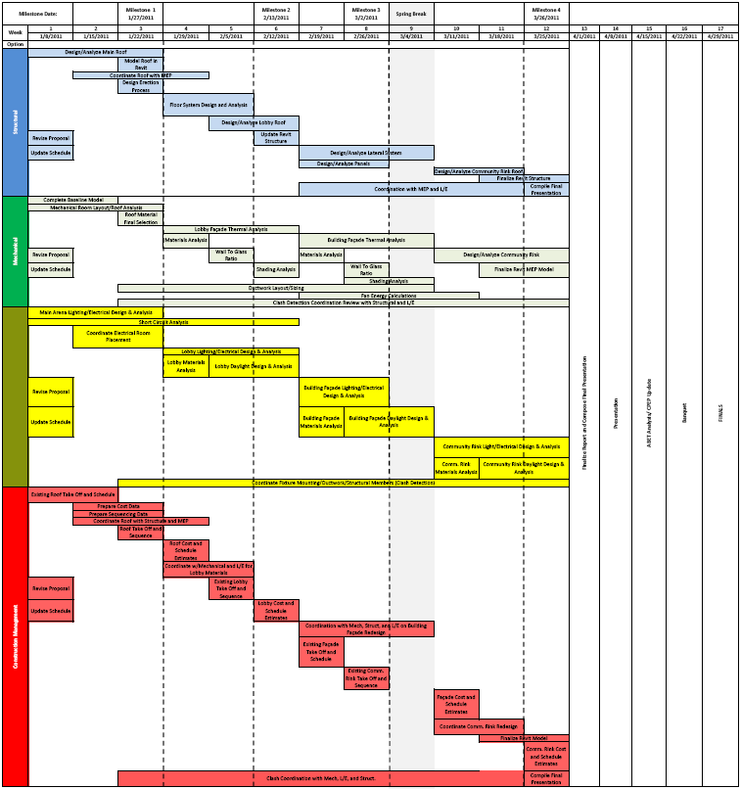
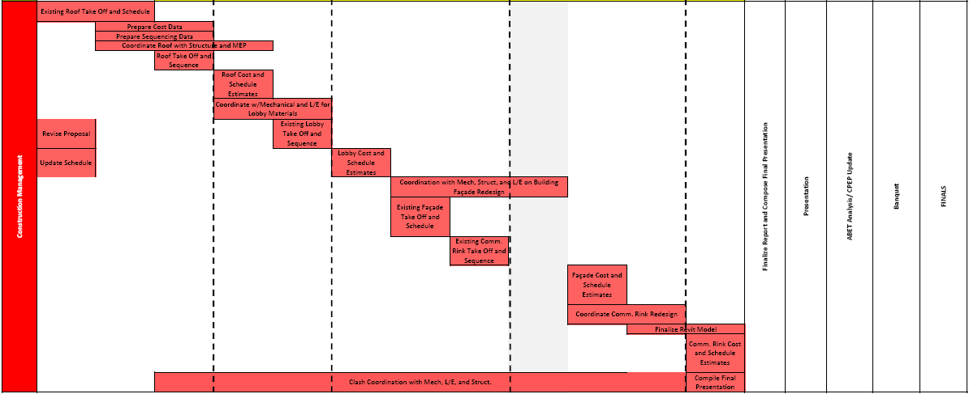
Introduction BIM Goals/Coordination Main Roof Redesign Façade Redesign Community Rink Redesign Conclusion
Project Schedule
Nate Babyak Alex Ho Brian Sampson Alex Schreffler

Slide 5
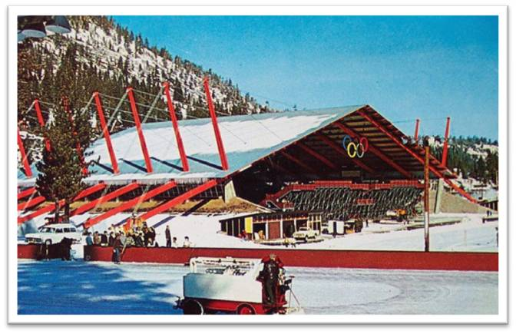
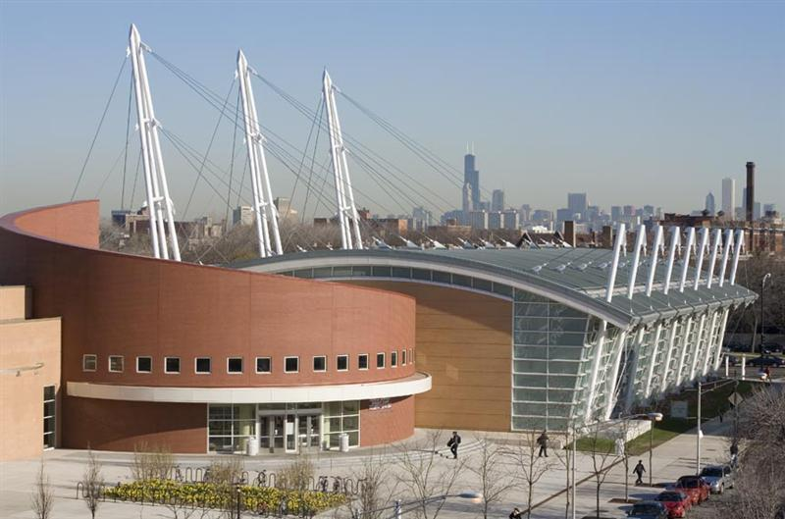
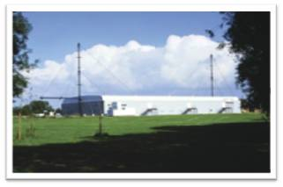
Introduction BIM Goals/Coordination Main Roof Redesign Façade Redesign Community Rink Redesign Conclusion
Main Roof Redesign Logic
inspirations
Create an Iconic Symbol for Penn State Hockey
Reduce the Size of the Roof Girders/Trusses
Reduce Volume of the Main Arena
Coordinate MEP and Structural
Create an Efficient Erection Procedure
Nate Babyak Alex Ho Brian Sampson Alex Schreffler

Slide 6
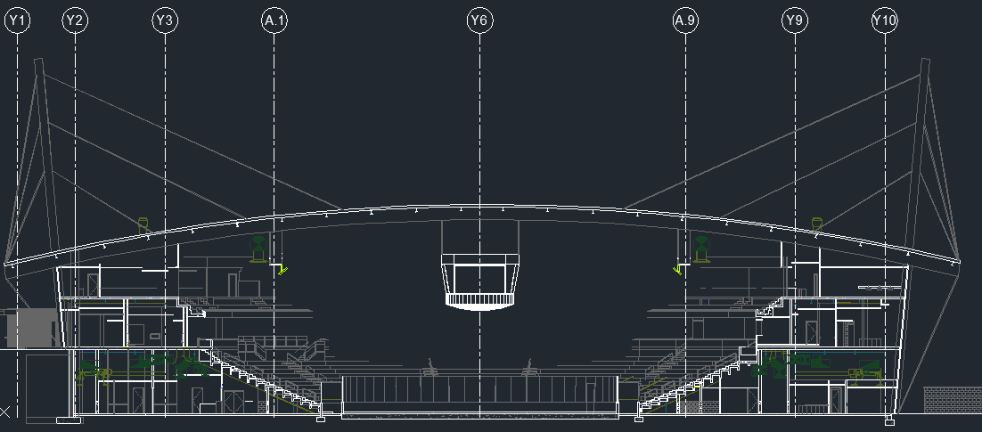
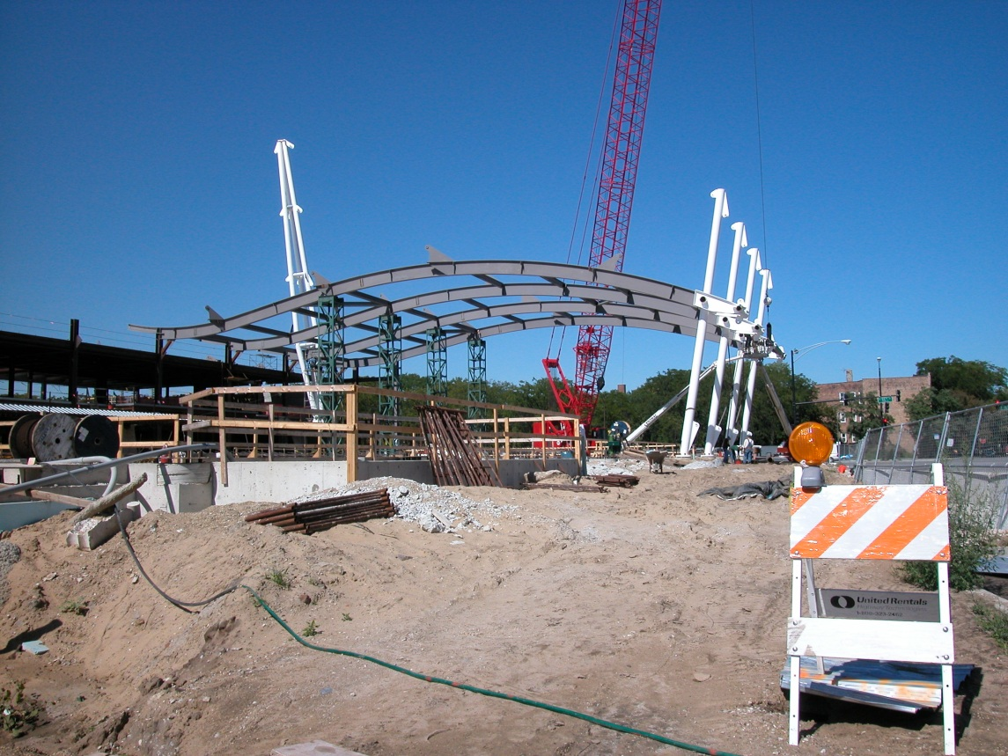
Introduction BIM Goals/Coordination Main Roof Redesign Façade Redesign Community Rink Redesign Conclusion
Main Roof Redesign Logic
Proposed Design
Erection Process
Create an Iconic Symbol for Penn State Hockey
Reduce the Size of the Roof Girders/Trusses
Reduce Volume of the Main Arena
Coordinate MEP and Structural
Create an Efficient Erection Procedure
Nate Babyak Alex Ho Brian Sampson Alex Schreffler

Slide 7
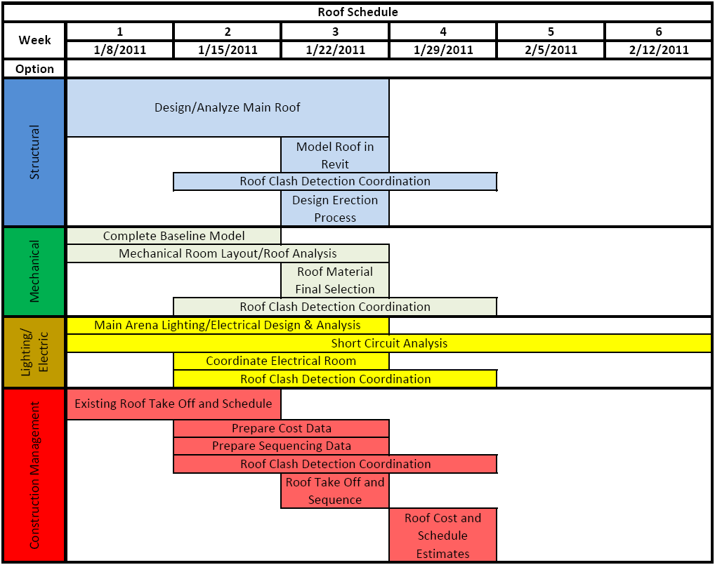
Introduction BIM Goals/Coordination Main Roof Redesign Façade Redesign Community Rink Redesign Conclusion
Main Roof Redesign Logic
Roof Redesign Tasks and Tools
Discipline | Secondary Tasks | Programs to be Used | References
Structural | Design/Analyze Cable Stay Mast, Cables, Roof Girder | SAP, Revit | ASCE 7-10, ASCE 19-96, AISC Steel Manual 13 Ed., ACI 318-08
 | Adjust Interior Steel Framing | RAM, Revit | AISC Steel Manual 13 Ed.
 | Design Erection Process | SAP, Navisworks | AISC Steel Manual 13 Ed.
Construction Management | Cost Analysis | Revit Architecture, Revit Structure, MS Excel | RS Means, Vendor(s)
 | Schedule Analysis | Microsoft Project, Navisworks | RS Means, Vendor(s)
 | Site Plan Analysis | AutoCad, Adobe Acrobat, MS Excel | -
Mechanical | Roof Composition | H.A.M. Toolbox/Trane Trace 700 | -
 | Mechanical Room Layout | Revit MEP 2012 | -
 | Main Bowl Ductwork Layout | Revit MEP 2012 | -
 | Shaft Coordination | Revit MEP 2012 | -
Lighting/Electrical | Arena Lighting Analysis | AGi32 | NCAA Recommendations ASHRAE 90.1
 | Arena Lighting/Catwalk/ Scoreboard Structural Loads | - | Coordiante with Structural Member
 | Circuit/Panel Redesign | Revit MEP | NEC 2011
Create an Iconic Symbol for Penn State Hockey
Reduce the Size of the Roof Girders/Trusses
Reduce Volume of the Main Arena
Coordinate MEP and Structural
Create an Efficient Erection Procedure
Nate Babyak Alex Ho Brian Sampson Alex Schreffler

Slide 8
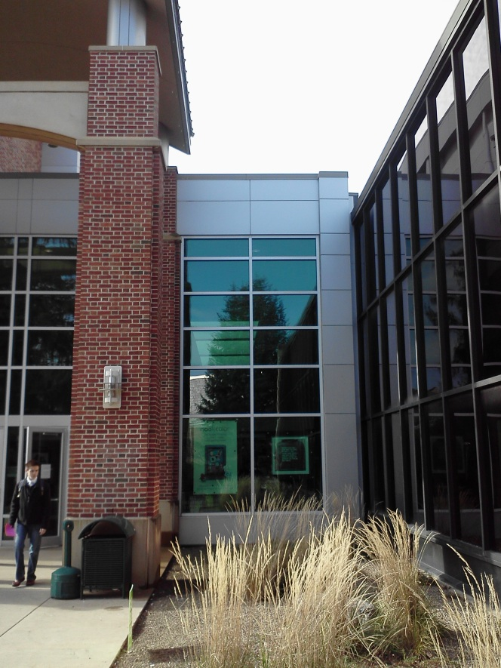
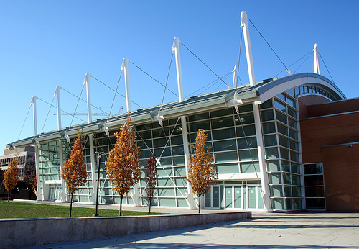
Introduction BIM Goals/Coordination Main Roof Redesign Façade Redesign Community Rink Redesign Conclusion
Façade Redesign Logic
Create a Lightweight Façade of Glass and Metal Panels
Optimize Daylighting
Architectural Lighting
Possible Integration of Lateral Bracing
Nate Babyak Alex Ho Brian Sampson Alex Schreffler

Slide 9
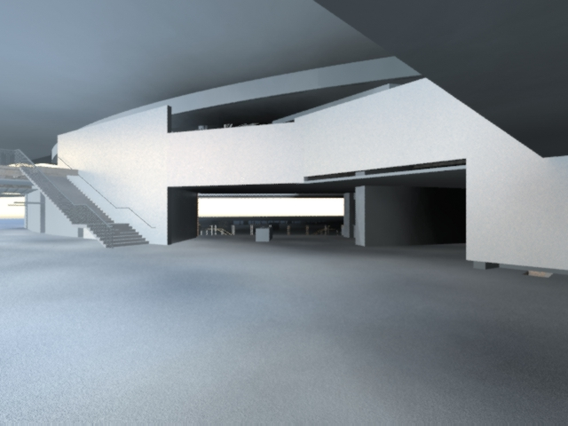
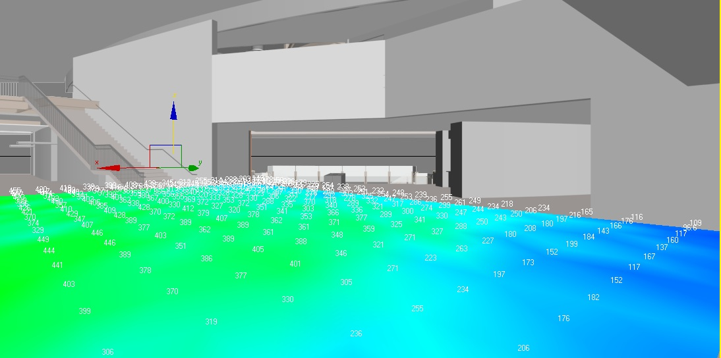
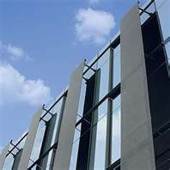
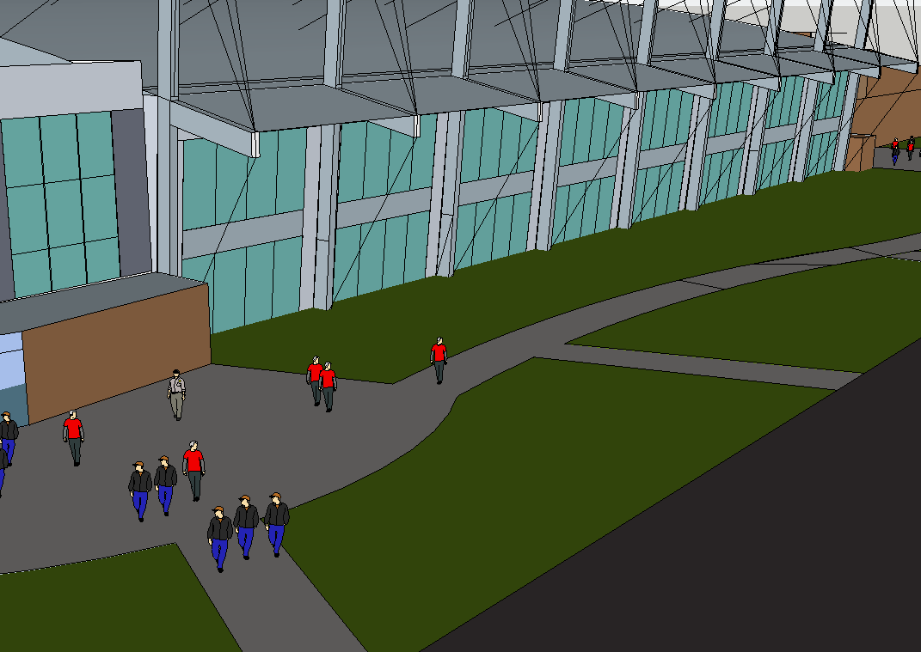
Introduction BIM Goals/Coordination Main Roof Redesign Façade Redesign Community Rink Redesign Conclusion
Façade Redesign Logic
Create a Lightweight Façade of Glass and Metal Panels
Optimize Daylighting
Architectural Lighting
Possible Integration of Lateral Bracing
Nate Babyak Alex Ho Brian Sampson Alex Schreffler

Slide 10
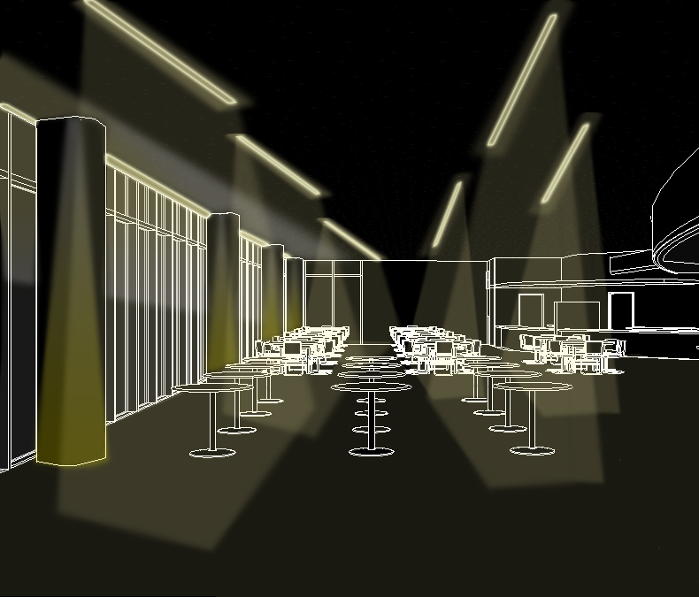
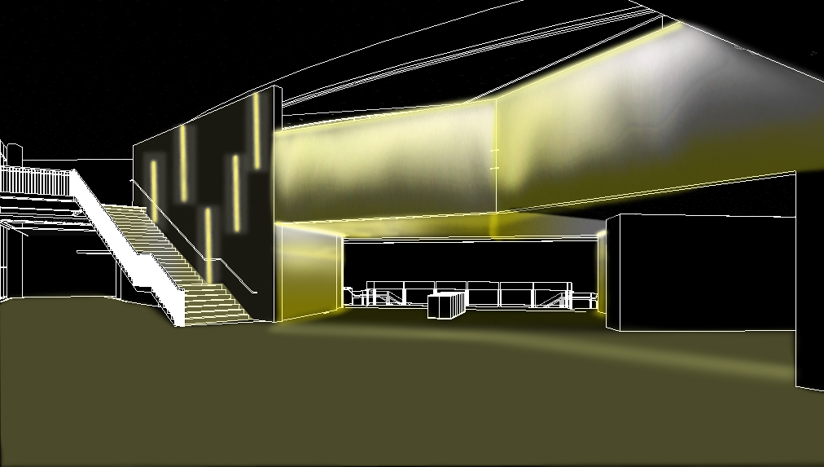
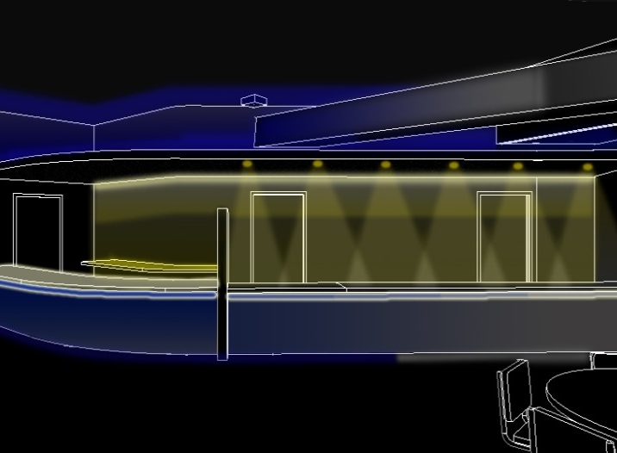
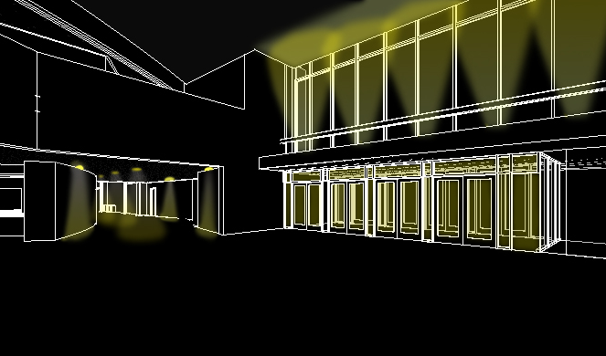
Introduction BIM Goals/Coordination Main Roof Redesign Façade Redesign Community Rink Redesign Conclusion
Façade Redesign Logic
Create a Lightweight Façade of Glass and Metal Panels
Optimize Daylighting
Architectural Lighting
Possible Integration of Lateral Bracing
Nate Babyak Alex Ho Brian Sampson Alex Schreffler

Slide 11
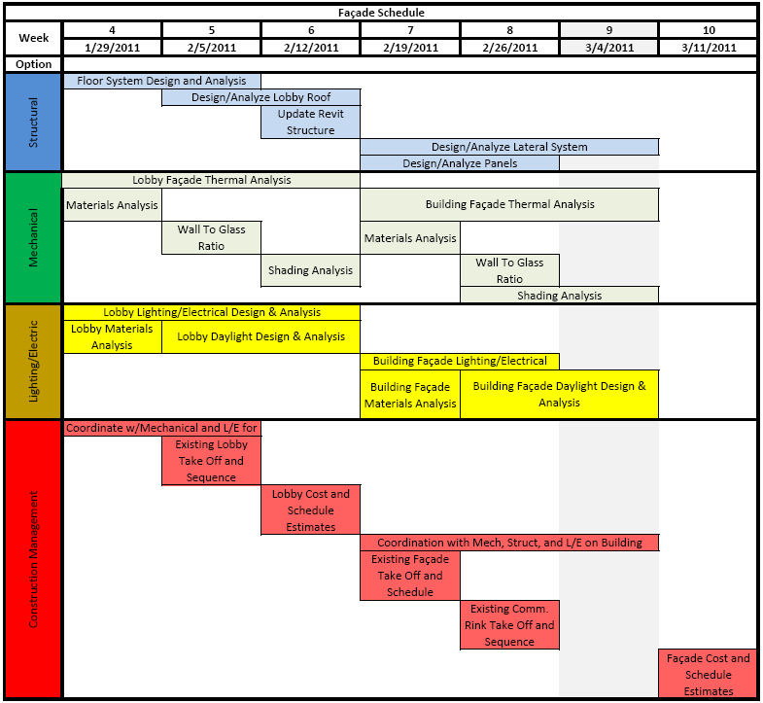
Introduction BIM Goals/Coordination Main Roof Redesign Façade Redesign Community Rink Redesign Conclusion
Façade Redesign Logic
Façade Redesign Tasks and Tools
Discipline | Secondary Tasks | Programs to be Used | References
Structural | Design Panels (wind, earthquake, gravity, etc) | ETABS, MS Excel | ASCE 7-10
 | Lateral System Design/ Analysis | ETABS, RAM | ASCE 7-10, AISC Steel Manual 13th Ed.
Construction Management | Cost Analysis | Revit Architecture, MS Excel | RS Means, Vendor(s)
 | Schedule Analysis | MS Project, Navisworks | RS Means, Vendor(s)
 | Site Plan Analysis | AutoCad, Adobe Acrobat, MS Excel | Construction Manager
Mechanical | Wall Composition | H.A.M. Toolbox/Trane Trace 700 | -
 | Panel To Glass Ratio | Trane Trace 700 | -
 | Shading | Trane Trace 700 | -
Lighting/Electrical | Daylighting Analysis | Revit Architecture, AGi32, 3DS Max | IES 2011 Lighting Handbook
 | Shading Analysis | Revit Architecture, AGi32, 3DS Max | IES 2011 Lighting Handbook
 | Architectural Lighting Analysis | AGi32 | IES 2011 Lighting Handbook ASHRAE 90.1
 | Circuit/Panel Redesign | Revit MEP | NEC 2011
Create a Lightweight Façade of Glass and Metal Panels
Optimize Daylighting
Architectural Lighting
Possible Integration of Lateral Bracing
Nate Babyak Alex Ho Brian Sampson Alex Schreffler

Slide 12
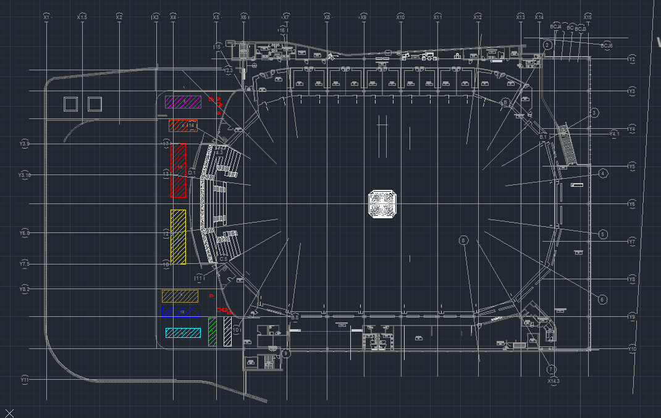
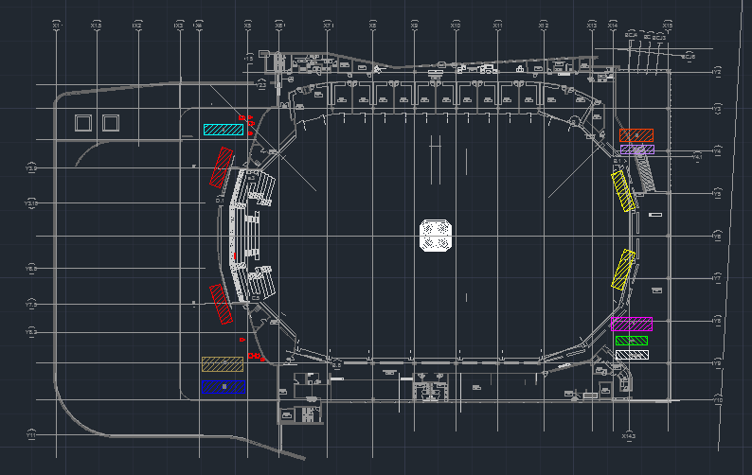
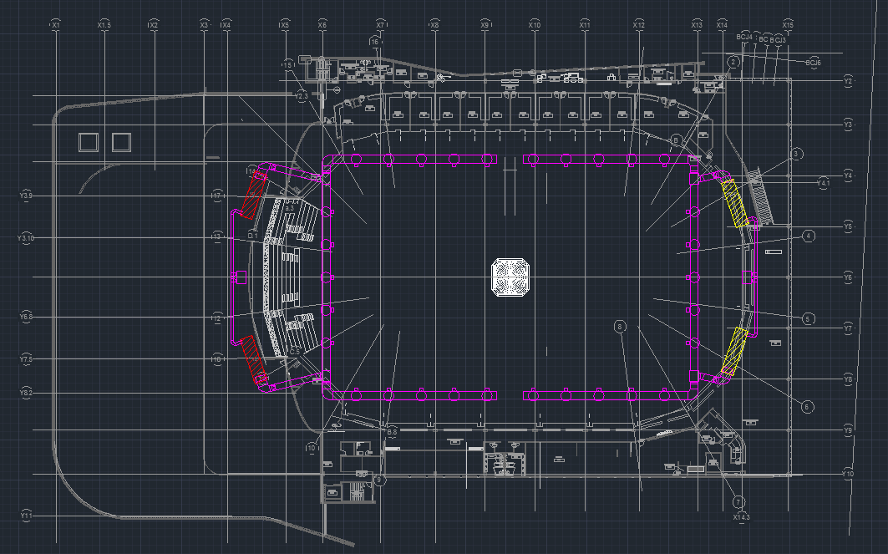
Introduction BIM Goals/Coordination Main Roof Redesign Façade Redesign Community Rink Redesign Conclusion
Community Rink Redesign Logic
Move Mechanical Units to Increase Fan Efficiency
Flexible Roof Design
Coordinate Daylighting
Coordinate Mechanical Shafts with Structure
Nate Babyak Alex Ho Brian Sampson Alex Schreffler

Slide 13
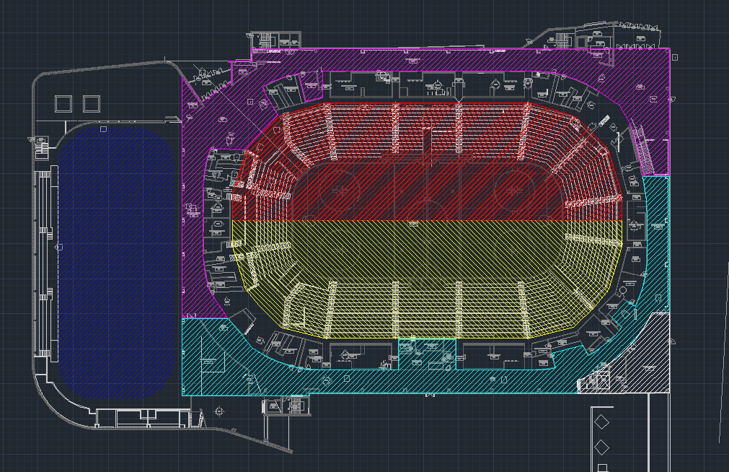
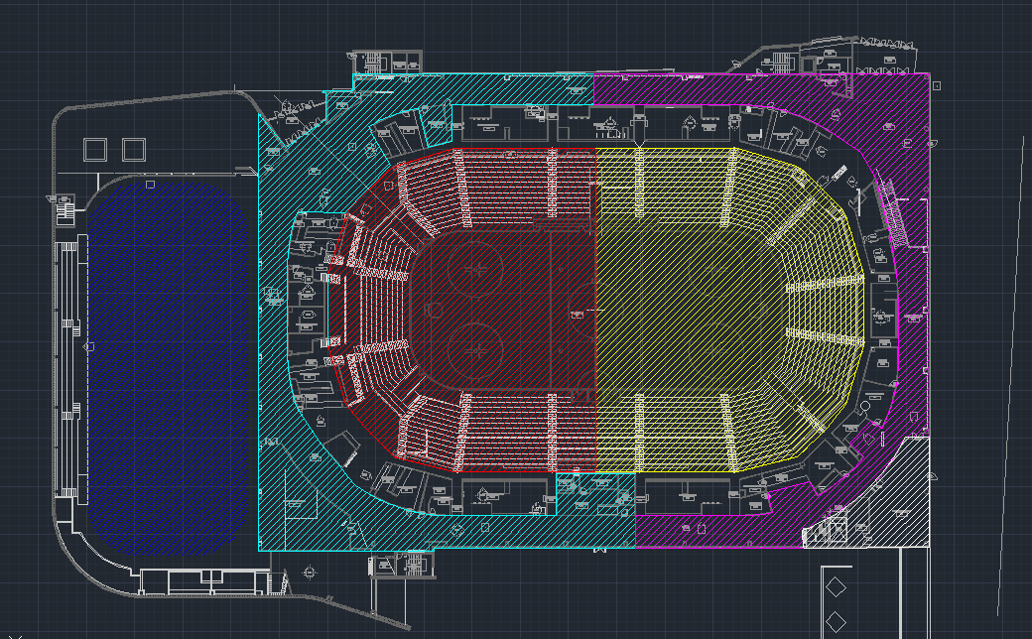
Introduction BIM Goals/Coordination Main Roof Redesign Façade Redesign Community Rink Redesign Conclusion
Community Rink Redesign Logic
Move Mechanical Units to Increase Fan Efficiency
Flexible Roof Design
Coordinate Daylighting
Coordinate Mechanical Shafts with Structure
Nate Babyak Alex Ho Brian Sampson Alex Schreffler

Slide 14
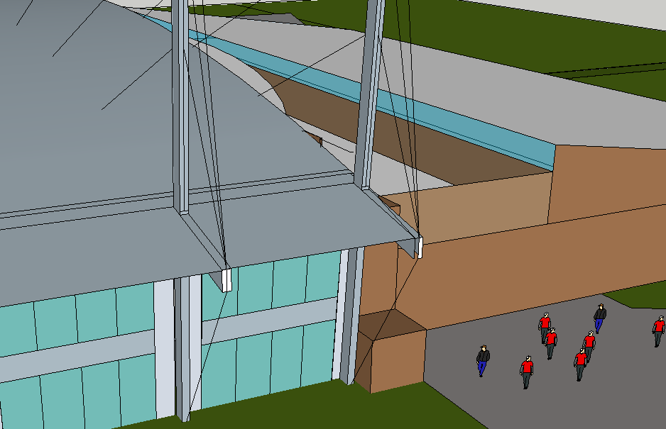
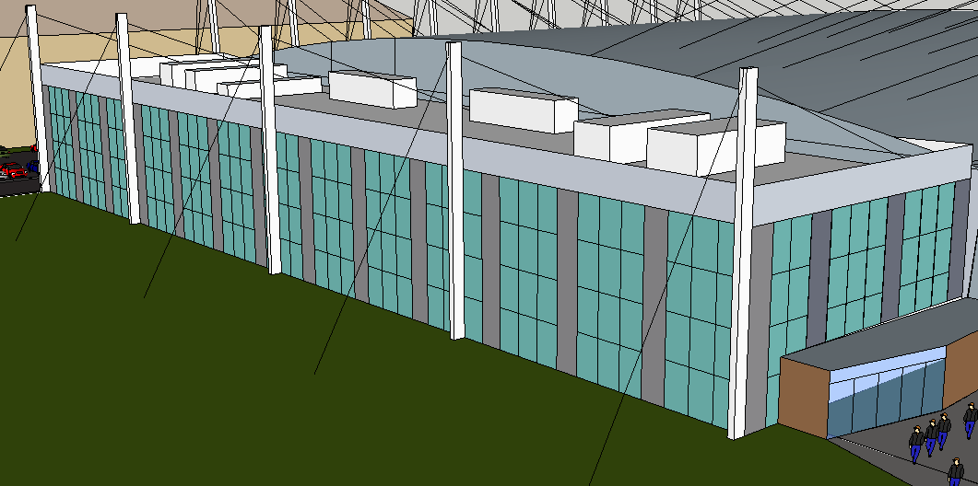
Introduction BIM Goals/Coordination Main Roof Redesign Façade Redesign Community Rink Redesign Conclusion
Community Rink Redesign Logic
Move Mechanical Units to Increase Fan Efficiency
Flexible Roof Design
Coordinate Daylighting
Coordinate Mechanical Shafts with Structure
Nate Babyak Alex Ho Brian Sampson Alex Schreffler

Slide 15
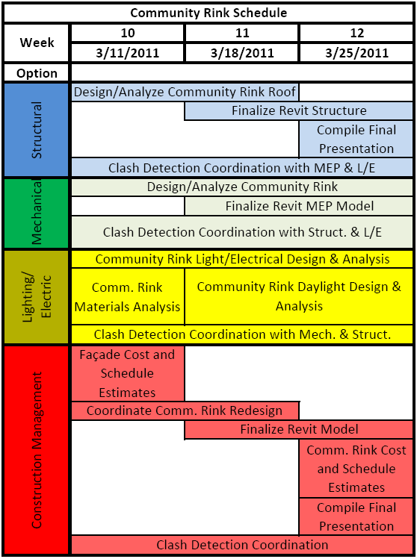
Introduction BIM Goals/Coordination Main Roof Redesign Façade Redesign Community Rink Redesign Conclusion
Community Rink Redesign Tasks and Tools
Discipline | Secondary Tasks | Programs to be Used | References
Structural | Design/Analyze Lobby Roof for Mechanical Units | SAP, Revit | ASCE 7-10, ASCE 19-96, AISC Steel Manual 13 Ed.
 | Design/Analyze Community Rink Roof | RAM, Revit | ASCE 7-10, AISC Steel Manual 13 Ed.
Construction Management | Cost Analysis | Revit Architecture, Revit Structure, MS Excel | RS Means, Vendor(s)
 | Schedule Analysis | Microsoft Project | RS Means, Vendor(s)
 | Site Plan Analysis | AutoCad, Adobe Acrobat, MS Excel | Construction Manager
 | MEP Coordination | Navisworks, MS Project | -
Mechanical | Roof Analysis | Trane Trace 700 | -
 | Façade Analysis | H.A.M. Toolbox/Trane Trace 700 | -
 | Ductwork Layout | Revit MEP 2012 | -
Lighting/Electrical | Community Rink Lighting Analysis | AGi32 | NCAA Recommendations ASHRAE 90.1
 | Daylighting Analysis | Revit Architecture, AGi32, 3DS Max | IES 2011 Lighting Handbook
 | Solar Thermal Gain Analysis | Trane Trace 700 | Coordinate with Mechanical Member
 | Circuit/Panel Redesign | Revit MEP | NEC 2011
Community Rink Redesign Logic
Move Mechanical Units to Increase Fan Efficiency
Flexible Roof Design
Coordinate Daylighting
Coordinate Mechanical Shafts with Structure
Nate Babyak Alex Ho Brian Sampson Alex Schreffler

Slide 16
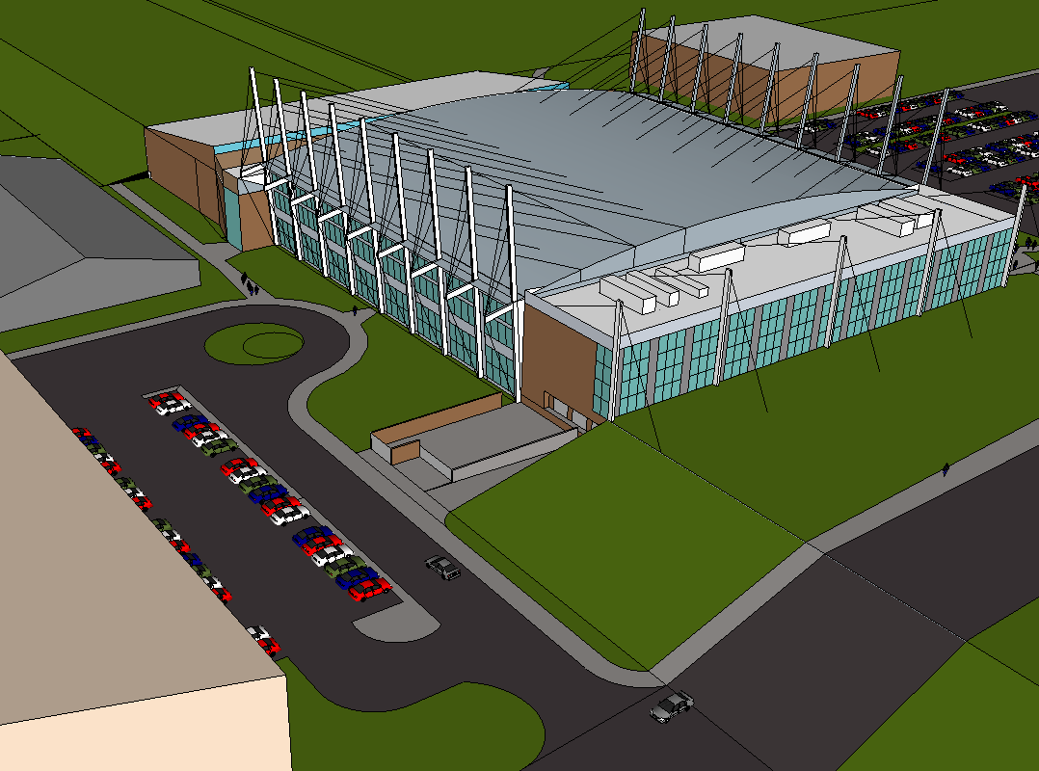
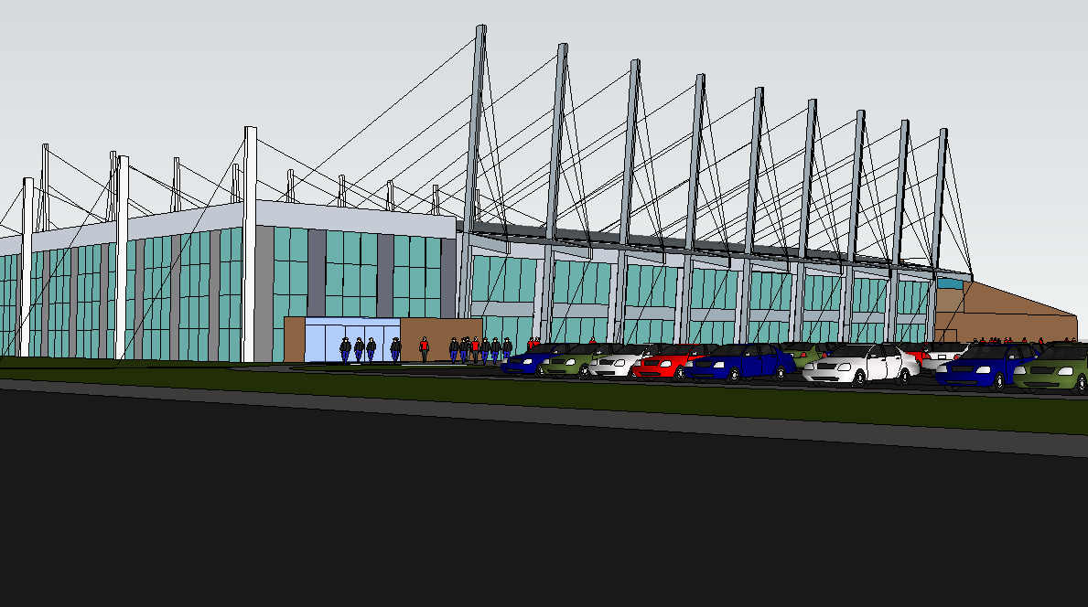
Introduction BIM Goals/Coordination Main Roof Redesign Façade Redesign Community Rink Redesign Conclusion
Group Milestones
Conclusion
Milestone 1: January 27, 2011
Main Roof Redesign Complete
Milestone 2: February 13, 2011
Lobby Design Complete
Milestone 3: March 2, 2011
Façade Design Complete
Milestone 4: March 26, 2011
Community Rink Design Complete
Main Roof Redesign
Create an iconic symbol for Penn State hockey with increased structural efficiency
Façade Redesign
Create an energy efficient lightweight facade
Community Rink Redesign
Create a more efficient mechanical system while incorporating daylighting strategies
Nate Babyak Alex Ho Brian Sampson Alex Schreffler

